Slide 1

Interpreting State-of-the-Art NLP Models
Logesh Kumar Umapathi, Data Scientist

Slide 2
Agenda :
How is Interpretation useful ?
Overview of Interpretation techniques
Live examples
Q&A

Slide 3


Slide 4
Why Interpretation is necessary ? :
How does your model really make its decisions?
How can I trust your model?

Slide 5

Makes you trust your own model !

Slide 6

Make your users to trust your model !

Slide 7

Look for the mistakes / biases
Source : https://thumbs.gfycat.com/CarefulSandyFluke-max-1mb.gif

Slide 8
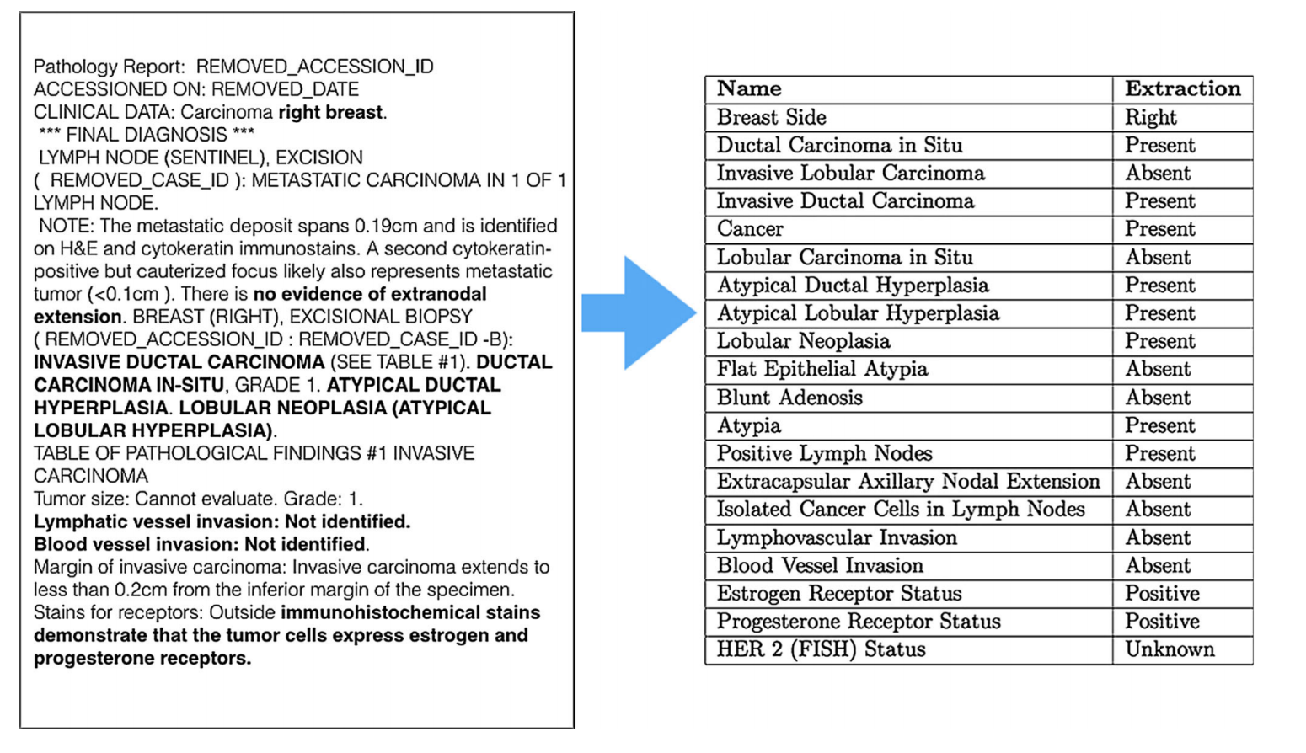
Source : Yala et el , Using machine learning to parse breast pathology reports. Breast cancer research and treatment

Slide 9
Interpretation Techniques:
Intrinsic - Attention based
Attention layers with sequence models
CRF with Attention
Interpreting transformers
Low level language features
Task Specific features
Extrinsic : Model Agnostic
LIME
SHAP

Slide 10

Let’s get started ...

Slide 11
Thank you 🙏
Code & Slides - https://bit.ly/2qSmSbI
For queries and feed back :
Twitter : @logesh_umapathi ,
Website : logeshumapathi.com ,
Email : logeshkumaru@gmail.com

Slide 12

Thank you!

